Slide 1
IST718 Advanced Information Analytics Course Introduction
Willard Williamson
Adjunct Professor
iSchool, Syracuse University
linkedin.com/in/ncc-1701-d

Slide 2
About me
Willard Williamson, Adjunct Professor, iSchool
Education:
Master of Liberal Arts (ALM), Software Engineering, Harvard Extension School
Advanced Graduate Certificate in Data Science, Harvard Extension School
Bachelor of Science, Computer Engineering Technology, Rochester institute of Technology
Professional
Sr. Software Engineer, Lockheed Martin
Current Position: Application of data science to common electronic warfare tasks
Radar system software
Real time software
Distributed systems
Systems programming

Slide 3
Outline
About me
Born and raised in Syracuse NY
Currently a Software Engineer at Northeast Information Discovery
Previously worked applied data scient submarine electronic warfare
Previously worked in Radar Systems: Signal processing, target detection, systems programming, distributed systems
Traveled all over the world working on Radar Systems

Slide 4
Faculty Assistant Introduction
Yash Suresh Pasar
Office Hours: Tuesday 10 to 12 AM
Office Location: Hinds Hall, 2nd Floor, Office 239
Yash will send an email to the class if office hours will be cancelled or if there is a time change. Cancellation emails will be sent as far in advance as possible.

Slide 5
In class rules
Provide a high quality learning environment
Laid back course atmosphere
It is always okay to arrive late / leave early though we prefer that you are here ontime and for the whole class.
Eating / drinking during class is fine
Always okay to ask questions
Please do not text / talk on the phone during class

Slide 6
About you
Attendance
Where are you from
Why are you taking this class: Degree / Data Science Certificate

Slide 7
Course Overview
Syllabus Overview
What is big data
What is Spark
About the course
Student work environment overview

Slide 8
Syllabus Overview
Syllabus Review

Slide 9
About the course
1/4 of the course covers prerequisite skills required for big data analytics
Python programming, understanding machine learning
1/4 of the course covers the Spark and Hadoop, providing skills required to perform big data analytics.
1/4 of the course consists of case studies, where you apply your skills and knowledge to real-world applications.
1/4 of the course consists of a project, where you work in groups in a real world application
Blackboard final exam covering high level course concepts

Slide 10
Course roadmap
Dealing with big data: tools and algorithms
(Case 3) Ensemble models; wisdom of the crowd
(Case 1) Linear models; supervised learning
(Case 2) Dimensionality reduction; unsupervised learning
(Case 4) Deep learning; highly non-linear models
Foundations of Statistical Learning (probability, model validation)
Small/medium data
Low model complexity
High interpretability
Low computational power
Big data
High model complexity
Low interpretability
High computational power

Slide 11
Academic Integrity Policy
Problem sets are to be done on your own
You may discuss problems with other students at a high level.
The overall guiding principal in IST-718 is that you submit your own work.
It’s okay to get ideas from others, but everything you submit is your own work.
The overall goal of the policy is to encourage thoughtful discussion between students to enhance the learning process while requiring students to do their own work.

Slide 12
Academic Integrity Policy Continued
All students are required to complete a short ungraded academic an academic integrity policy quiz on Blackboard
All students are required to get a score of 100% on the quiz or risk being unregistered from the course

Slide 13
Academic Honesty Continued
Students who violate the academic integrity policy will receive a grade of 0 for the assignment.
In addition, the professor reserves the right to report gross academic integrity violations to the iSchool academic authorities which could lead to sanctions by the University including being kicked out of the course

Slide 14
Introduction to Data Science

Slide 15
What is Data Science
A combination of disciplines:
Information / Computer science
Mathematics
Linear Algebra
Statistics
Research / Management Science
Domain Knowledge
With the goal of:
Using data for the purposes of gaining actionable insights
If you do this, then you are a data scientist, and the artifacts you produce are data products.
Notes:
data science as multi-disciplinary with the goal of using data to make decisions.

Slide 16
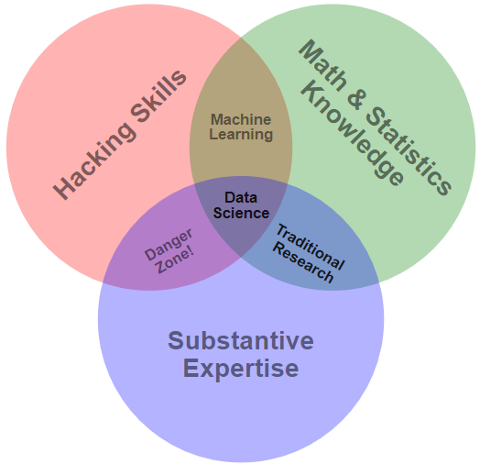
Data Science Venn Diagram*
*Drew Conway: https://s3.amazonaws.com/aws.drewconway.com/viz/venn_diagram/data_science.html
Notes:
Hacking skills represents programming, software expertise, and data manipulation abilities.
Danger zone represents creating analysis without knowledge of how you got there, common among people with subject expertise and the ability to generate their own results technically.

Slide 17
”Classic” data science
Expert is in charge of creating model
Expert is in charge of providing features that describe or predict new data
Expert typically produces small models
Expert typically produces very transparent and easy to understand models

Slide 18
Big data

Slide 19
What is Big Data?
Data with the following characteristics:
Data Volume too large to store on a single system.
Data Velocity too fast for processing by a single computer.
Data Variety too complex for traditional processing techniques.
These are known as the “three V’s” of big data.

Slide 20
Classic Data Science vs. Big Data
Classic data science
Big-data data science
Expert is in charge of creating model
Expert is in charge of providing features that describe or predict new data
Expert typically produces small models
Expert typically produces very transparent and easy to understand models
Generally, there is no expert
Model used is very general or there is no model at all!
Features are very low level (e.g., raw transactions vs credit scores)
Models are very large when fit (e.g., Baidu speech recognition is several terabytes)
Models are black boxes and almost impossible to understand

Slide 21
What will this course Cover?
Prescriptive
Predictive
Difficulty
“Foresight”
Descriptive
Diagnostic
Retrospective: “What Happened?”
Diagnostic: “Why did it happen?”
Descriptive: “What is happening now?”
Predictive: “What is likely to happen?”
Prescriptive: “What should I do about it?”
“Insight”
Retrospective
“Hindsight”
Business Value

Slide 22
What will this course cover? (2)
Prescriptive
Predictive
Difficulty
“Foresight”
Descriptive
Diagnostic
Retrospective: “What Happened?”
Diagnostic: “Why did it happen?”
Descriptive: “What is happening now?”
Predictive: “What is likely to happen?”
Prescriptive: “What should I do about it?”
“Insight”
Retrospective
“Hindsight”
Business Value
Notes:
Retrospective: “What Happened?”
Diagnostic: “Why did it happen?”
Descriptive: “What is happening now?”
Predictive: “What is likely to happen?”
Prescriptive: “What should I do about it?”

Slide 23
First steps
The sooner your start playing with Python and Spark, the better
Create an account on Databricks community edition https://community.cloud.databricks.com
Optional
Install Anaconda Python 3 http://docs.anaconda.com/anaconda/install/
Go to http://spark.apache.org and read the documentation
Do “Quick Start”, and maybe ”SQL, DataFrames, and Datasets”
See how the API is structured http://spark.apache.org/docs/latest/api/python/index.html

